Slide 2
Absence of Copyright
This slideshow contains photos, diagrams, and information, some of which were attained through internet searches of public websites. The author of this presentation does not own the copyright on this information, so this slideshow is for personal use only—not for sale or profit. Please utilize it to seek the Lord and grow in your knowledge of His Word and ways.

Slide 4
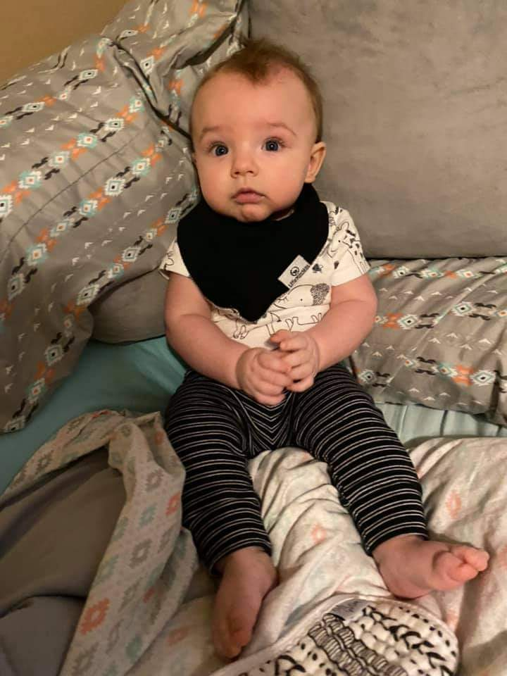
So, what will we learn tonight?

Slide 5
Prayer and Announcements
Sunday: 9:15 Fellowship
9:30 SS Master Class
10:30 Worship
Revelation Study available on our church website
www.faithprinceton.org
Email questions and comments to
pastor@faithprinceton.org

Slide 7
END HERE August 12, 2020
LAST WEEK 13 Revelation 8
BEGIN HERE AUGUST 19, 2020
Notes:
After the sixth seal has been opened (Revelation 6)...
The 144,000 are sealed with the seal of the Living (Loving) God... To mark ownership, protection, and loyalty
In Rev 7:9ff we will hear about a multitude of believers in heaven!

Slide 8
REVELATION CHAPTERS 8-14
The Seventh Seal is opened and gives way to the Seven Trumpet Judgments and Two Interludes.

Slide 9
The Seven Trumpets
Began last week...
Notes:
Leon Morris, Tyndale
Notes that the first four trumpet judgments are reminiscent of the Egyptian plagues in the Exodus.
The fifth and sixth aren’t clearly so, but then:
“In 15:3 the coming of Christ is tacitly compared to the exodus (the redeemed sing the song of Moses and of the Lamb); it is comprehensible, therefore, that the final redemption, the second exodus, is heralded by similar plagues as at the first exodus.”
This verse introduces a new series of events. SEVEN priests blew TRUMPETS in the Old Testament (1Chron 15:24). In Josh 6 the seven trumpets sounded prior to the FALL and DESTRUCTION of Jericho (Josh 6:4). So in Revelation SEVEN angels receive SEVEN TRUMPETS which sound prior to the end of the world.
Number 10:7-10 show the PURPOSE of trumpets:
Call for DELIVERANCE from enemies.
Show GLADNESS
Announce SOLEMN DAYS
Announce the beginning of MONTHS Announce BURNT OFFERING, SACRIFICE and
PEACE OFFERINGS
Acts as MEMORIALS.
NB. The Feast of TRUMPETS HERALDED THE SOLEMN DAY OF ATONEMENT when the ark was seen in Godʼs temple (Lev 23:24-27). Indeed the sounding of the 7th trumpet actually refers to the ark being seen in Godʼs temple in heaven (Rev 11:19).
Sounding trumpets preceeded the DESTRUCTION OF THE ENEMY in the battle of Jericho (Josh 6).
Sounding trumpets also preceeded the DESTRUCTION OF THE ENEMY in the time of Gideon (Jud 7:19-23).
Revelationʼs trumpets therefore point to: WAR; A CALL TO GOD (See Rev 9:20); HERALD THE DAY OF ATONMENT; and preceed THE FALL AND DESTRUCTION OF AN ENEMY OF GODʼS PEOPLE.
??? Interesting view of fall of pagan rome and papal rome ??? https://www.returnofelias.org/post/revelation-8-the-seven-trumpets

Slide 10
Revelation 8:10-11 The Third Trumpet
10 The third angel sounded, and a great star fell from heaven, burning like a torch, and it fell on a third of the rivers and on the springs of waters. 11 The name of the star is called Wormwood; and a third of the waters became wormwood, and many men died from the waters, because they were made bitter.
Notes:
KJ and Major comment:
??? ASTEROID HITTING THE EARTH ??? Near misses measured in millions of miles, but probabilities and possibilities remain—especially at the direction of God. All things in the universe serve His commands!

Slide 11
Revelation 8:13 The Coming Woes
13 Then I looked, and I heard an eagle flying in midheaven, saying with a loud voice, “Woe, woe, woe to those who dwell on the earth, because of the remaining blasts of the trumpet of the three angels who are about to sound!”
Notes:
END OF CHAPTER 8
An eagle that speaks human language?

Slide 12
END HERE August 12, 2020
WEEK 14 Revelation 9
BEGIN HERE AUGUST 19, 2020

Slide 13
Revelation 9:1-6 The Fifth Trumpet
1 Then the fifth angel sounded, and I saw a star from heaven which had fallen to the earth; and the key of the bottomless pit was given to him. 2 He opened the bottomless pit, and smoke went up out of the pit, like the smoke of a great furnace; and the sun and the air were darkened by the smoke of the pit. 3 Then out of the smoke came locusts upon the earth, and power was given them, as the scorpions of the earth have power....
Notes:
star from heaven which had fallen to the earth – an angel serving God’s purposes – probably not Satan!
key of the bottomless pit was given to him – Newport, 206
The bottomless pit in verses 1-2 is a provisional place of punishment for Satan until the end when he is thrown into the “lake of fire” (20:1-3, 10). The bottomless pit is also the abode of the beast or Antichrist before he appears on earth (11:7). This pit will also be the temporary prison of Satan during the millenial reign of the place of imprisonment of demons (Luke 8:31).
In this particular case, it is the abode of hosts of demons who fly forth, like scorpions, to plague people (v. 3). It should be noted that Revelation does not uniformly represent Satan as having his abode in the underworld. In chapter 12, Satan is represented as a fiery red dragon who engages in a fearful conflict with the angel Michael in the upper heavens.

Slide 14
Revelation 9:1-6 cont. The Fifth Trumpet
4 They were told not to hurt the grass of the earth, nor any green thing, nor any tree, but only the men who do not have the seal of God on their foreheads. 5 And they were not permitted to kill anyone, but to torment for five months; and their torment was like the torment of a scorpion when it stings a man. 6 And in those days men will seek death and will not find it; they will long to die, and death flees from them.
Notes:
4 They were told not to hurt the grass of the earth, nor any green thing, nor any tree, but only the men who do not have the seal of God on their foreheads. = PROTECTION for those who do have the seal of the Living (Loving) God on their heads! (see Rev 7:2-3)
Newport, 206. We are reminded of Israel and Egypt. God sent the plagues upon the Egyptians. They suffered terribly, even to the loss of the firstborn, but Israel was preserved. When the blood of the lamb was sprinkled over the door of an Israelite family, the angel of death passed over the family. The judgment of God did not fall upon the members of that family.
The church will suffer persecution and martyrdom in the tribulation, but will not suffer the WRATH OF GOD.
Cont.......... =>

Slide 15
Revelation 9:1-6 cont. The Fifth Trumpet
4 They were told not to hurt the grass of the earth, nor any green thing, nor any tree, but only the men who do not have the seal of God on their foreheads. 5 And they were not permitted to kill anyone, but to torment for five months; and their torment was like the torment of a scorpion when it stings a man. 6 And in those days men will seek death and will not find it; they will long to die, and death flees from them.
Notes:
5 And they were not permitted to kill anyone, but to torment for five months = God puts limits even on the pain that the ungodly are going through !!! He has timetables we know nothing about!
and their torment was like the torment of a scorpion when it stings a man. 6 And in those days men will seek death and will not find it; they will long to die, and death flees from them.

Slide 16
Revelation 9:7-10 Locusts
7 The appearance of the locusts was like horses prepared for battle; and on their heads appeared to be crowns like gold, and their faces were like the faces of men. 8 They had hair like the hair of women, and their teeth were like the teeth of lions. 9 They had breastplates like breastplates of iron; and the sound of their wings was like the sound of chariots, of many horses rushing to battle. 10 They have tails like scorpions, and stings; and in their tails is their power to hurt men for five months.
Notes:
7 The appearance = John could only describe the things as he saw them... He wouldn’t be able to describe military weapons such as helicopters, fighter jets, etc. Are these locusts spiritual in nature or physical? OR BOTH?
of the locusts was like horses prepared for battle; and on their heads appeared to be crowns like gold, and their faces were like the faces of men. 8 They had hair like the hair of women, and their teeth were like the teeth of lions. 9 They had breastplates like breastplates of iron; and the sound of their wings was like the sound of chariots, of many horses rushing to battle. 10 They have tails like scorpions, and stings; and in their tails is their
Power to hurt men for five months. Just as in Job, God puts limitations on the power to harm men. 5 months is a typical life span of locusts. Temporary!!! Everything but the things of God are temporary.
Compare Joel 2
1 Blow a trumpet in Zion,
And sound an alarm on My holy mountain!
Let all the inhabitants of the land tremble,
For the day of the Lord is coming;
Surely it is near,
2 A day of darkness and gloom,
A day of clouds and thick darkness.
As the dawn is spread over the mountains,
So there is a great and mighty people;
There has never been anything like it,
Nor will there be again after it
To the years of many generations.
3 A fire consumes before them
And behind them a flame burns.
The land is like the garden of Eden before them
But a desolate wilderness behind them,
And nothing at all escapes them.
4 Their appearance is like the appearance of horses;
And like war horses, so they run.
5 With a noise as of chariots
They leap on the tops of the mountains,
Like the crackling of a flame of fire consuming the stubble,
Like a mighty people arranged for battle.
6 Before them the people are in anguish;
All faces turn pale.
7 They run like mighty men,
They climb the wall like soldiers;
And they each march in line,
Nor do they deviate from their paths.
8 They do not crowd each other,
They march everyone in his path;
When they burst through the defenses,
They do not break ranks.
9 They rush on the city,
They run on the wall;
They climb into the houses,
They enter through the windows like a thief.
10 Before them the earth quakes,
The heavens tremble,
The sun and the moon grow dark
And the stars lose their brightness.
11 The Lord utters His voice before His army;
Surely His camp is very great,
For strong is he who carries out His word.
The day of the Lord is indeed great and very awesome,
And who can endure it?
12 “Yet even now,” declares the Lord,
“Return to Me with all your heart,
And with fasting, weeping and mourning;
13 And rend your heart and not your garments.”
Now return to the Lord your God,
For He is gracious and compassionate,
Slow to anger, abounding in lovingkindness
And relenting of evil.
14 Who knows whether He will not turn and relent
And leave a blessing behind Him,
Even a grain offering and a drink offering
For the Lord your God?
15 Blow a trumpet in Zion,
Consecrate a fast, proclaim a solemn assembly,
16 Gather the people, sanctify the congregation,
Assemble the elders,
Gather the children and the nursing infants.
Let the bridegroom come out of his room
And the bride out of her bridal chamber.
17 Let the priests, the Lord’s ministers,
Weep between the porch and the altar,
And let them say, “Spare Your people, O Lord,
And do not make Your inheritance a reproach,
A byword among the nations.
Why should they among the peoples say,
‘Where is their God?’”

Slide 17
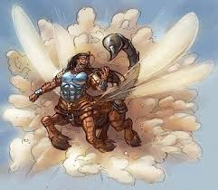
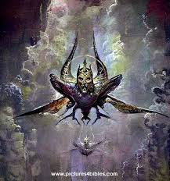
Notes:
STRANGE DESCRIPTION
Rev 9:7-10
7 The appearance of the locusts was like horses prepared for battle; and on their heads appeared to be crowns like gold, and their faces were like the faces of men. 8 They had hair like the hair of women, and their teeth were like the teeth of lions. 9 They had breastplates like breastplates of iron; and the sound of their wings was like the sound of chariots, of many horses rushing to battle. 10 They have tails like scorpions, and stings; and in their tails is their power to hurt men for five months.

Slide 18
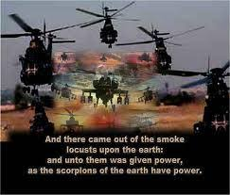
Notes:
MAYBE ???
OR SYMBOLIC ???
Rev 9:7-10
7 The appearance of the locusts was like horses prepared for battle; and on their heads appeared to be crowns like gold, and their faces were like the faces of men. 8 They had hair like the hair of women, and their teeth were like the teeth of lions. 9 They had breastplates like breastplates of iron; and the sound of their wings was like the sound of chariots, of many horses rushing to battle. 10 They have tails like scorpions, and stings; and in their tails is their power to hurt men for five months.

Slide 19
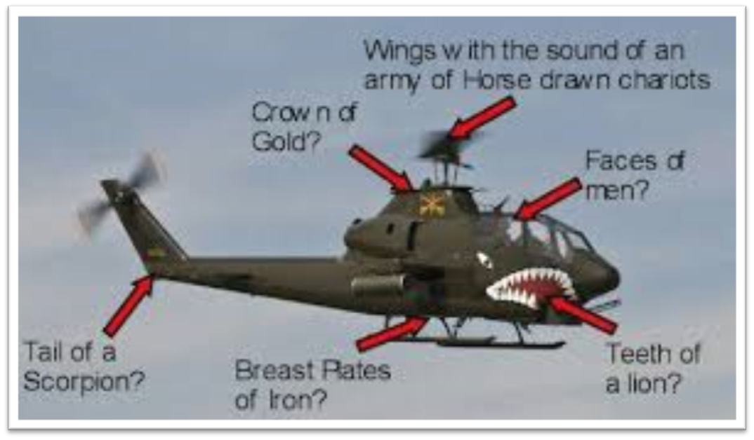
Notes:
INTERESTING THEORY....
Rev 9:7-10
7 The appearance of the locusts was like horses prepared for battle; and on their heads appeared to be crowns like gold, and their faces were like the faces of men. 8 They had hair like the hair of women, and their teeth were like the teeth of lions. 9 They had breastplates like breastplates of iron; and the sound of their wings was like the sound of chariots, of many horses rushing to battle. 10 They have tails like scorpions, and stings; and in their tails is their power to hurt men for five months.

Slide 20
Revelation 9:11-12 The Destroyer
11 They have as king over them, the angel of the abyss; his name in Hebrew is Abaddon, and in the Greek he has the name Apollyon.
12 The first woe is past; behold, two woes are still coming after these things.
Notes:
11 They have as king over them, the angel of the abyss;
his name in Hebrew is Abaddon, and in the Greek he has the name Apollyon. (Destroyer)
Satan? Or evil archangel? Or human emperor or leader if figurative?
In eternity, Satan will not be in charge of Hell. He will be the most punished.
(Matthew 25:41 Judgment of Sheep and Goats: Then He will also say to those on His left, 'Depart from Me, accursed ones, into the eternal fire which has been prepared for the devil and his angels; for I was hungry...)
Revelation 20:10 ESV And the devil who had deceived them was thrown into the lake of fire and sulfur where the beast and the false prophet were, and they will be tormented day and night forever and ever.
2 Peter 2:4 ESV / For if God did not spare angels when they sinned, but cast them into hell and committed them to chains of gloomy darkness to be kept until the judgment;
Jude 1:6-7 ESV 6 And the angels who did not stay within their own position of authority, but left their proper dwelling, he has kept in eternal chains under gloomy darkness until the judgment of the great day—7 Just as Sodom and Gomorrah and the surrounding cities, which likewise indulged in sexual immorality and pursued unnatural desire, serve as an example by undergoing a punishment of eternal fire.

Slide 21
Revelation 9:11-12 The Destroyer
11 They have as king over them, the angel of the abyss; his name in Hebrew is Abaddon, and in the Greek he has the name Apollyon.
12 The first woe is past; behold, two woes are still coming after these things.
Notes:
12 The first woe is past; behold, two woes are still coming after these things.
Ellicott's Commentary for English Readers
(11) And they had a king . . .--Better, They have over them as king (not "the angel," as in English version) an angel of the abyss; his name (is) in Hebrew Abaddon, and in the Greek he has a name, Apollyon. There is more than one point in which the seer wishes us to mark the contrast between these symbolical and the natural locusts. Locusts have no sting; these have. Locusts have no king (Proverbs 30:27); these have a king. The movements of the invading locusts are conducted with wonderful precision and order, yet no presiding monarch arranges their march; but here there is a directing and controlling head. The great movement is no mere undesigned or instinctive one, but the offspring of a hidden, spiritual force. The great battle is not on the surface only, the invasions, revolutions, tyrannies, which try and trouble mankind, involve spiritual principles, and are but tokens of the great conflict between the spirit of destruction and the spirit of salvation, between Christ and Belial, God and Mammon, the Prince of this world and the Prince of the kings of the earth. The king of these locust hordes is named in Hebrew Abaddon, or Perdition (from the Latin perderde for “to destroy”), a name sometimes given to the place or abode of destruction (Job 26:6). "Destruction (Abaddon) hath no covering"--i.e., before God. (Comp. Proverbs 15:11). In Greek his name is Apollyon, or Destroyer: The spirit of the destroyer is the spirit that inspires these hosts. It is a great movement, but its end is destruction, as its inspiring genius is from beneath, from an angel of the nether world. It is not necessary for us to seek some great historical personage for the fulfilment of this portion of the prophecy, any more than we ought to accept any great historical event as an exhaustive fulfilment of the vision. The picture is vivid and forcible, and its full and certain meaning will be plain hereafter; but it at least should draw our minds from the curiosity which seeks for historical or personal counterparts to the self-vigilance which fears lest our own spirit should be injured by the prevalence of any form of evil. It should teach us to remember always the vehement, earnest way in which the sacred writers describe the subtle, venomous power of all sin, and the merciless destructiveness of its work. It is not of any invading hosts, or signal and special forms of evil, but of the terrible and usual influence of all sin, that the Apostle St. Paul writes when he describes the world-wide devastations of sin in language partly borrowed from the Old Testament, but singularly reminding us of the vision before us. "There is none that doeth good; no, not one. Their throat is an open sepulchre; the poison of asps is upon their lips; their feet are swift to shed blood; destruction and misery are in their ways; and the way of peace have they not known; there is no fear of God before their eyes" (Romans 3:12-18). It is perhaps well to notice that at this fifth trumpet the unseen spiritual powers of darkness appear taking part in the conflict. There is a time when the obstinate resistance of mankind (yes, and of individual men and women also) to better things becomes fortified by an evil spirit, and they are no longer passive resisters of good, but they become active antagonists of good, hating and obscuring the light of truth, and wounding the spirits and consciences of men. Alas! many walk of whom the Apostle could only say with tears, "they are the enemies of the cross of Christ" (the emblem of salvation), "and whose end is destruction" (Philippians 3:18-19).

Slide 22
Revelation 9:13-19 The Sixth Trumpet
13 Then the sixth angel sounded, and I heard a voice from the four horns of the golden altar which is before God, 14 one saying to the sixth angel who had the trumpet, “Release the four angels who are bound at the great river Euphrates.” 15 And the four angels, who had been prepared for the hour and day and month and year, were released, so that they would kill a third of mankind. 16 The number of the armies of the horsemen was two hundred million; I heard the number of them.
Notes:
FROM HORNS OF GOLEN ALTAR = commands are still coming from heaven. God is still in control. And what is happening is worship????
V 14. Release the four angels who are bound at the great river Euphrates...
The command is to loose the four angels bound at the Euphrates. What are these? Their number--four--represents powers influencing all quarters. They are angels (that is, messengers, or agencies) employed for the purpose. They are at or near the river Euphrates--that is, the spot whence the forces would arise. What is meant by the Euphrates? Are we to understand it literally? This can hardly be, unless we are prepared to take Babylon and Jerusalem literally also, and to deny all mystical meaning; but this is what only few will be disposed to do. The two cities, Babylon and Jerusalem, are the types of two radically different sets of ideas, two totally antagonistic views of life; and the meaning and mystical import of the River Euphrates must be determined by its relation to these two cities.
???? Angels who guard the garden of Eden??? Genesis 3:22-24 22Then the LORD God said, “Behold, the man has become like one of Us, knowing good and evil. And now, lest he reach out his hand and take also from the tree of life, and eat, and live forever...” 23Therefore the LORD God banished him from the Garden of Eden to work the ground from which he had been taken. 24So He drove out the man and stationed cherubim on the east side of the Garden of Eden, along with a whirling sword of flame to guard the way to the tree of life.…

Slide 23
Revelation 9:13-19 The Sixth Trumpet
13 Then the sixth angel sounded, and I heard a voice from the four horns of the golden altar which is before God, 14 one saying to the sixth angel who had the trumpet, “Release the four angels who are bound at the great river Euphrates.” 15 And the four angels, who had been prepared for the hour and day and month and year, were released, so that they would kill a third of mankind. 16 The number of the armies of the horsemen was two hundred million; I heard the number of them.
Notes:
V 15. “Prepared for the hour and day and month and year” ➔ exact timetable, down to the hour!!!!
a third of mankind = the fourth seal killed one-fourth of all people (6:4)... This third of those left means half of the world’s population is killed by this point!!!
V 16. 200,000,000 horsemen army!!!! = the AntiChrist army!!!

Slide 24
Revelation 9:13-19 cont. Fire and Brimstone
17 And this is how I saw in the vision the horses and those who sat on them: the riders had breastplates the color of fire and of hyacinth and of brimstone; and the heads of the horses are like the heads of lions; and out of their mouths proceed fire and smoke and brimstone. 18 A third of mankind was killed by these three plagues, by the fire and the smoke and the brimstone which proceeded out of their mouths. 19 For the power of the horses is in their mouths and in their tails; for their tails are like serpents and have heads, and with them they do harm.
Notes:
V 17 in the vision = these are things John saw in a vision and tried to explain... Not explanations of things that he wrote down!
out of their mouths proceed fire and smoke and brimstone = judgment
V 18 A third of mankind was killed by these three plagues, by the fire and the smoke and the brimstone which proceeded out of their mouths
V 19 power in mouth and tails = guns???? Weaponry in front and back of aircraft???

Slide 25
Revelation 9:20-21 No Repentance
20 The rest of mankind, who were not killed by these plagues, did not repent of the works of their hands, so as not to worship demons, and the idols of gold and of silver and of brass and of stone and of wood, which can neither see nor hear nor walk; 21 and they did not repent of their murders nor of their sorceries nor of their immorality nor of their thefts.
Notes:
V 20 The rest of mankind.... did not repent ....
Idols: which can neither see nor hear nor walk
V 21 did not repent of their murders... Sorceries... Immorality... Thefts...
2 Peter 3
3 Above all, you must understand that in the last days scoffers will come, scoffing and following their own evil desires. 4 They will say, “Where is this ‘coming’ he promised? Ever since our ancestors died, everything goes on as it has since the beginning of creation.” 5 But they deliberately forget that long ago by God’s word the heavens came into being and the earth was formed out of water and by water. 6 By these waters also the world of that time was deluged and destroyed. 7 By the same word the present heavens and earth are reserved for fire, being kept for the day of judgment and destruction of the ungodly.
8 But do not forget this one thing, dear friends: With the Lord a day is like a thousand years, and a thousand years are like a day. 9 The Lord is not slow in keeping his promise, as some understand slowness. Instead he is patient with you, not wanting anyone to perish, but everyone to come to repentance.
10 But the day of the Lord will come like a thief. The heavens will disappear with a roar; the elements will be destroyed by fire, and the earth and everything done in it will be laid bare.
11 Since everything will be destroyed in this way, what kind of people ought you to be? You ought to live holy and godly lives 12 as you look forward to the day of God and speed its coming. That day will bring about the destruction of the heavens by fire, and the elements will melt in the heat. 13 But in keeping with his promise we are looking forward to a new heaven and a new earth, where righteousness dwells.
14 So then, dear friends, since you are looking forward to this, make every effort to be found spotless, blameless and at peace with him. 15 Bear in mind that our Lord’s patience means salvation, just as our dear brother Paul also wrote you with the wisdom that God gave him.

Slide 26
END HERE AUGUST 19, 2020
WEEK 14
BEGIN HERE AUGUST 26, 2020

